Slide 1


http://tiny.cc/ovoapp

Slide 2
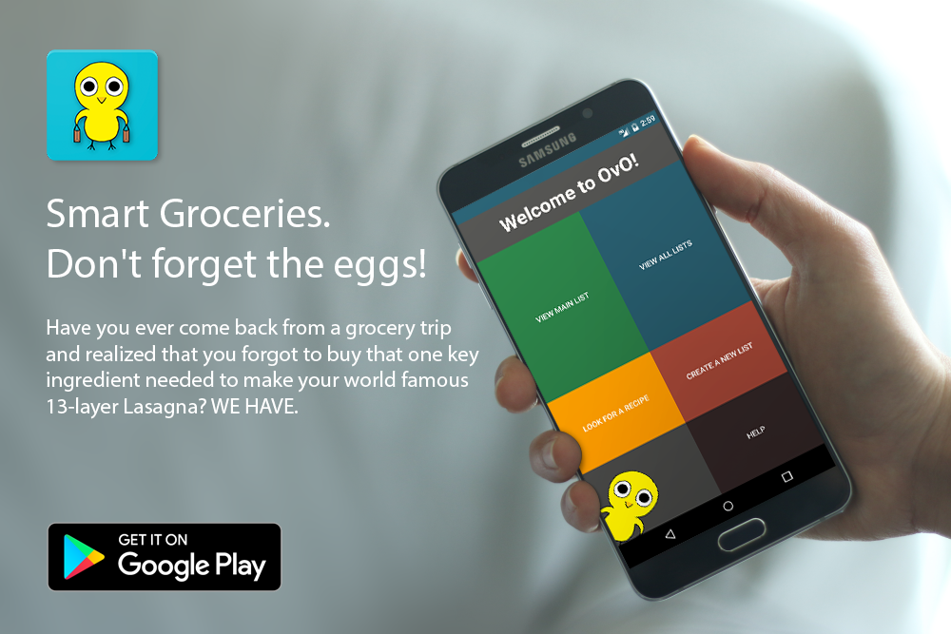

Slide 3
Don’t Forget the EGGS!
Team Leader: Omar Khan
List Adaption: Thiago Amaro
Database Creation: Ruth Hatch
Theme Design: James Quach

Slide 4
Introducing… OvO!
To put it simply, OvO is a grocery List app that can fill the void in your life.
Main Features Include:
Recipe Lookup
Custom Grocery List Creation
Grocery Store Mode
Unlimited List Merges
Unlimited List Creation
Beautiful WYSIWYG UI
It might seem small and simplistic but the implementation is key here… Stay put!

Slide 5
Our Mission
To create a unique & intuitive grocery app better than the rest of the competition

Slide 6




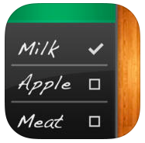

Research

Slide 7
Path to OvO
In the beginning we had big hopes and Ideas… In the end we still had big hopes and Ideas, just a tad bit smaller…
Original Goals:
Scan a Receipt, and generate grocery lists
Set Reminders for products to be bought
New Goals:
Ability to lookup a Recipe through keyword search
Ability to merge multiple lists into one

Slide 8
Scanning a Receipt
Utilized Tesseract OCR API
Performed extremely poorly with ~20-30% accuracy
Attempts made to optimize Tesseract with:
(Tried to) Train Tesseract to recognize a ‘Receipt Font’
Utilizing a Paint Activity
Only able to accurately read UPC Codes and rarely any words.
Inaccurate when reading a Receipt due to Layout
Too dependent on the quality of the User’s camera.

Slide 9
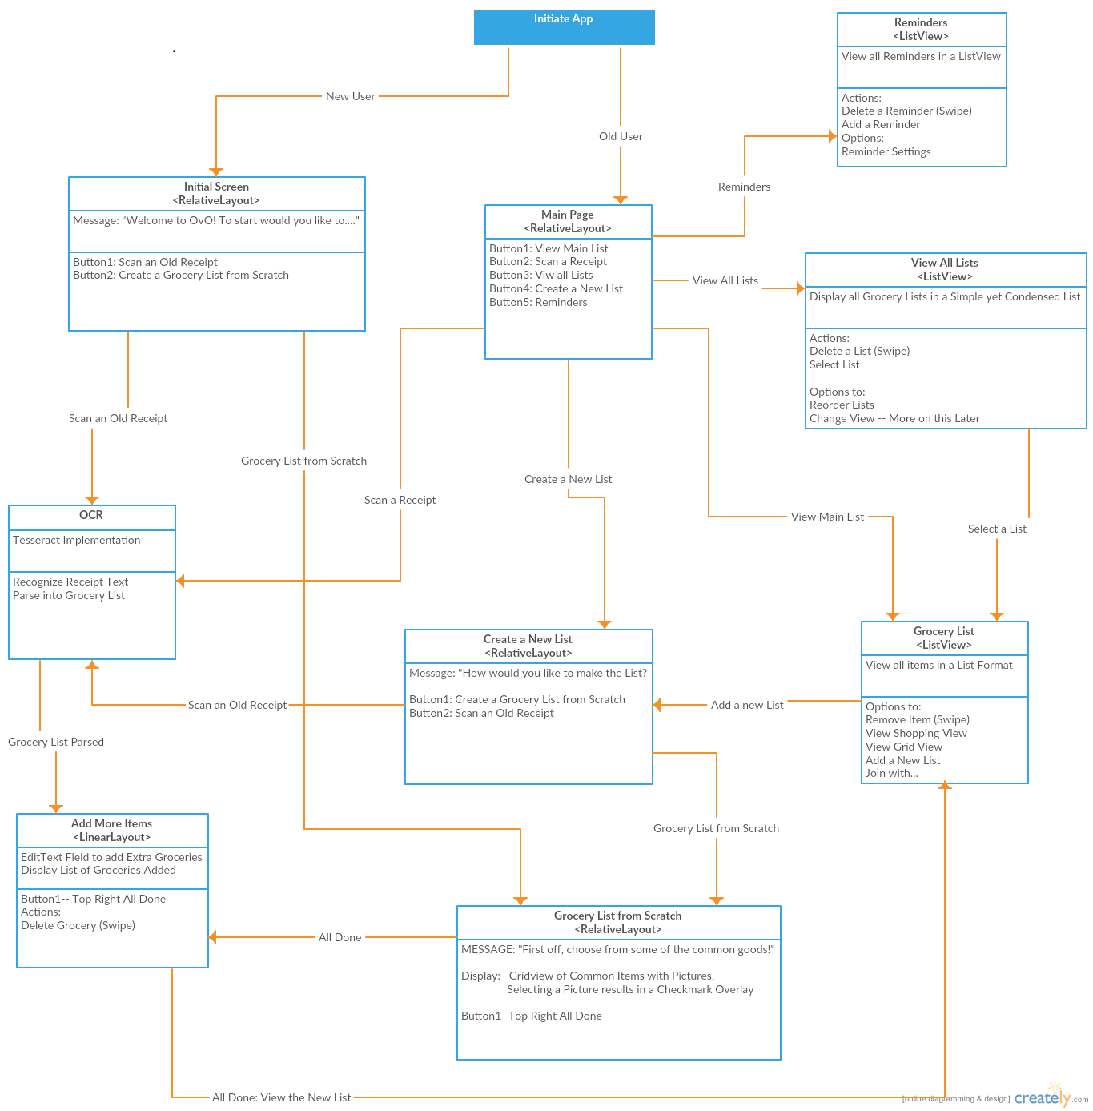

Slide 10
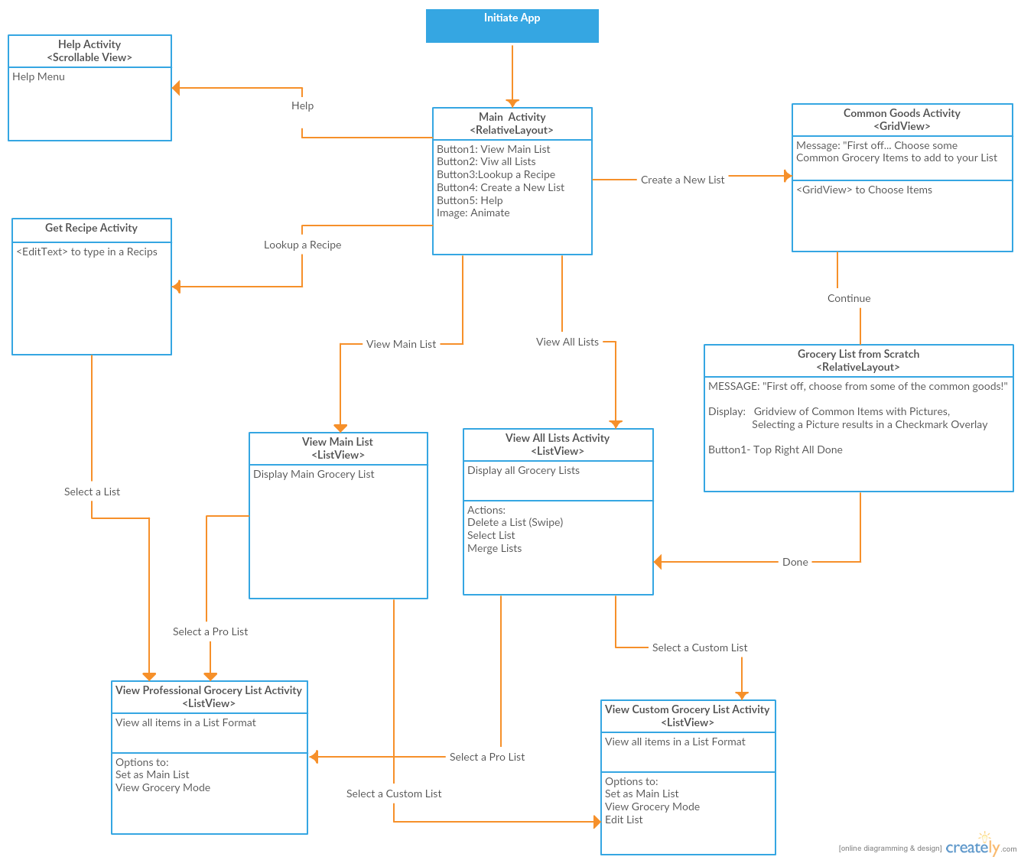

Slide 11
Challenges to OvO
James
Theme Design
Thiago
Creating Custom Adapters for List and Grid Views
Ruth
Creating an Optimal Database & Data Storage Design
Omar
Recipe Lookup and Parsing
UI Design

Slide 12
Theme Design
Activity Layout to Fit the Need
Eliminated unnecessary Back Buttons
KEEP IT SIMPLE STUPID
Notes:
JIM

Slide 13
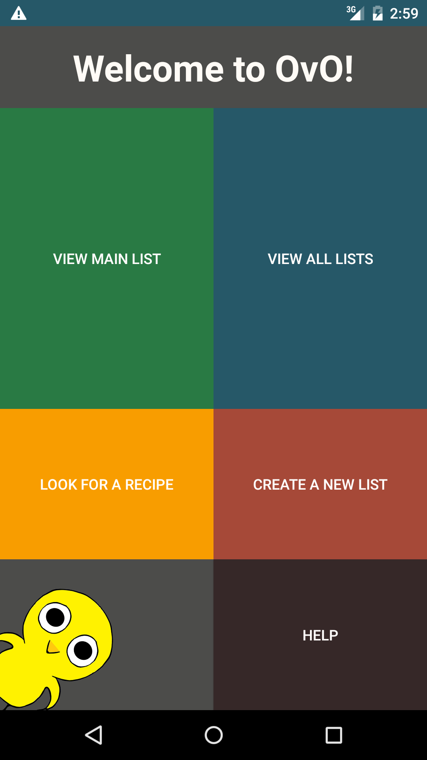
Layout created to display constantly no matter Screen Resolution/Aspect Ratio
Main Activity is a Linear Layout with:
TextView
3 Linear Layouts with Weights
1st inner Linear Layout has Weight of 2
Notes:
JIM

Slide 14
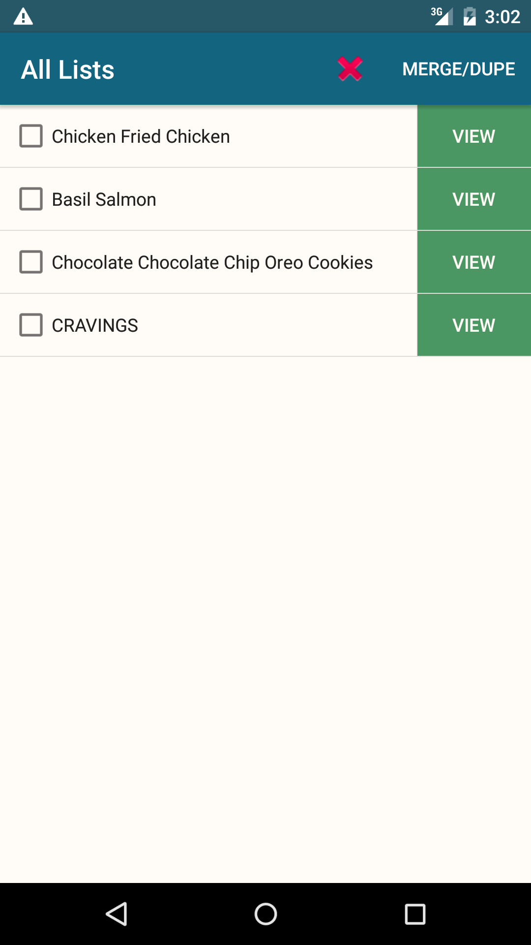
Layout created for minimal clutter and simplicity
Consists of AppBar with ToolBar and a ListView
Notes:
JIM

Slide 15
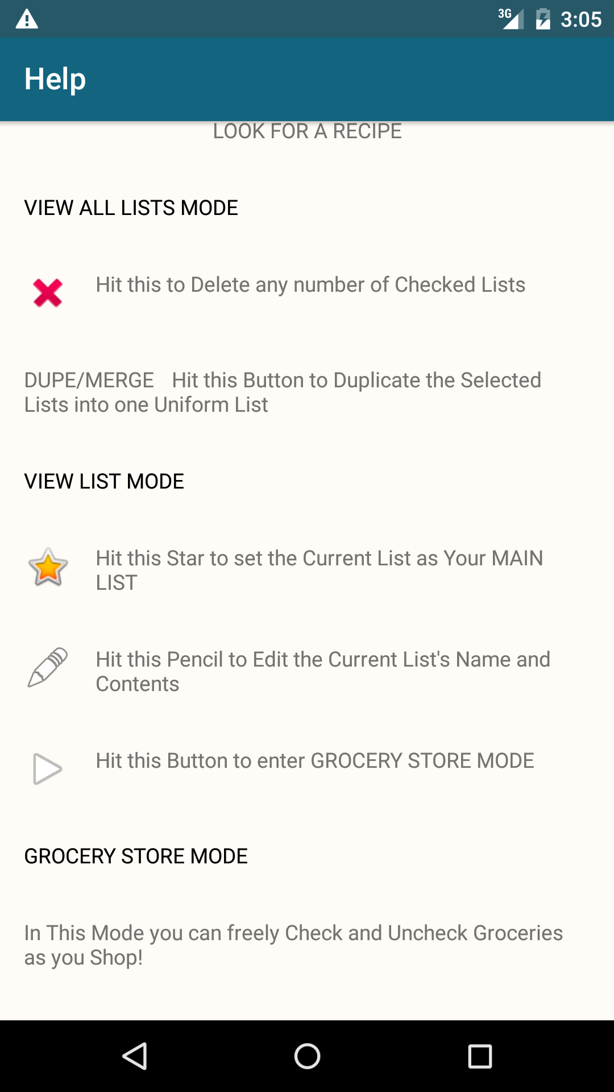
Scrollable View for Easy Reading
Notes:
JIM

Slide 16
Custom Adapters
Android comes with very BASIC layouts for List and Grid Items
Basic Layouts can only have either 1 image or 1 text
Needed to create custom adapters for our needs
Notes:
THIAGO

Slide 17
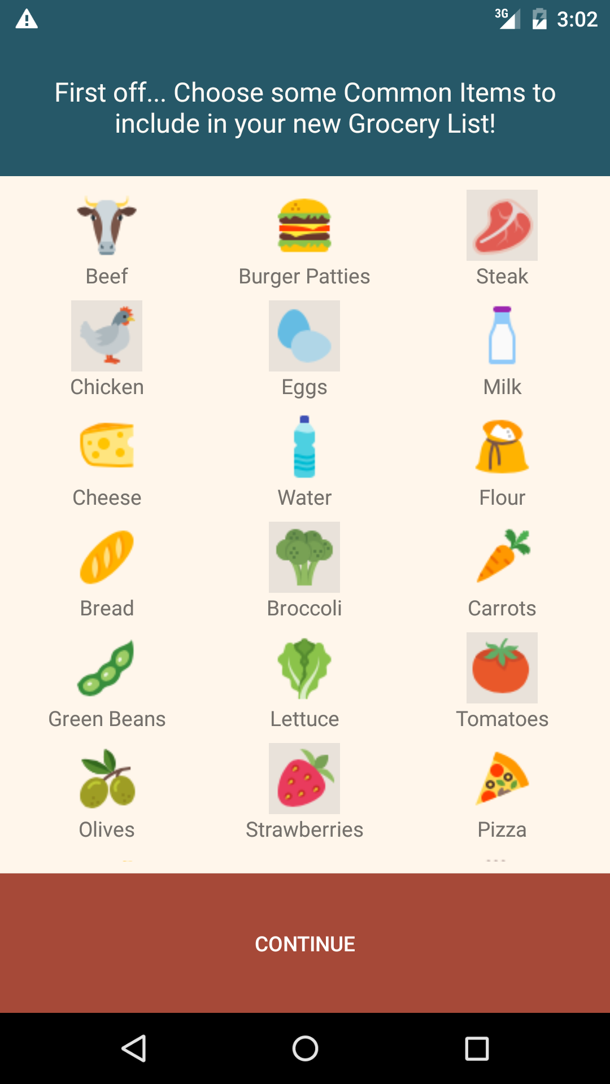
Each Grid Item consists of an ImageView and TextView
Create an Adapter to Populate GridView
input of ArrayList of Labels and ArrayList of Images
Convert Image and Label to a View Item
onGetView
Inflate layout
Attach Views Image and Label
Set View Tag
onClick
If Selected, darken background
Else lighten Background
Notes:
THIAGO

Slide 18
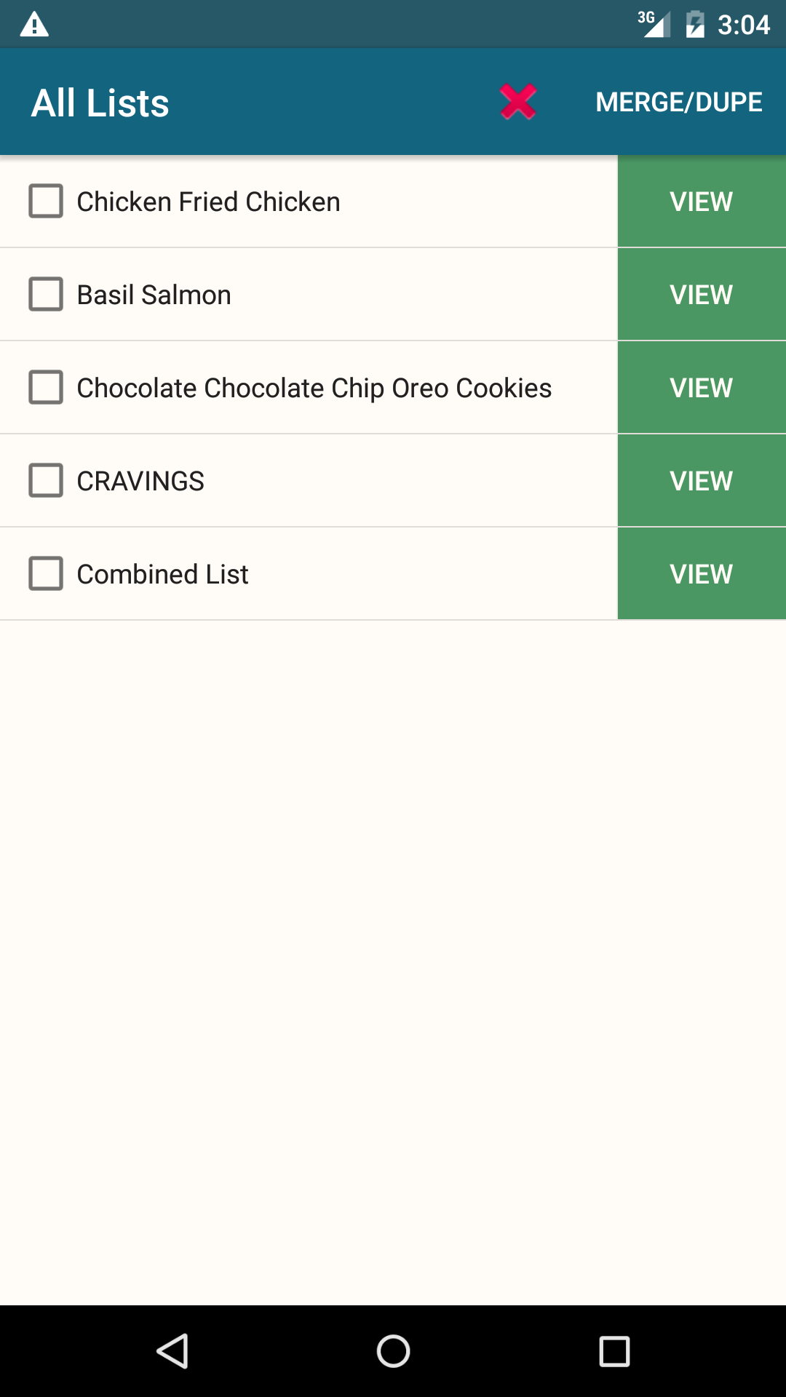
Each List Item has CheckedTextView and a View Button
Created Layout for each Button and implemented custom onClick Buttons for each piece of the Item
Used an Interface to access the onClick Listeners from each Item in Adapter
Notes:
THIAGO

Slide 19
Database Creation
Crucial Requirement: Integrity
Had to handle both Professional Lists and Custom Lists
Figure out Data Storage for Images, URLs, Lists...
Notes:
RUTH

Slide 20
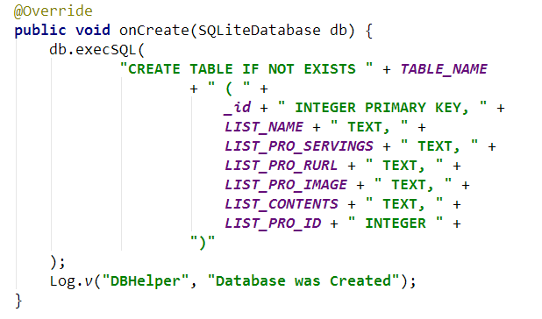
Database Creation
Chose to Store Images on Device Storage and store absolute Image Path in Database
Made Sure all Inserts were NON NULL
Left ID handling to SQL’s AUTOINCREMENT
Notes:
RUTH

Slide 21
Database Rules
All UPDATE, SELECT and DELETE queries must be called via _id to stop similar names from pulling wrong information
All Rows must have NON-NULL values
Each Query surrounded via TRY/CATCH
Database and Cursor MUST be closed regardless of Query Success
Notes:
RUTH

Slide 22
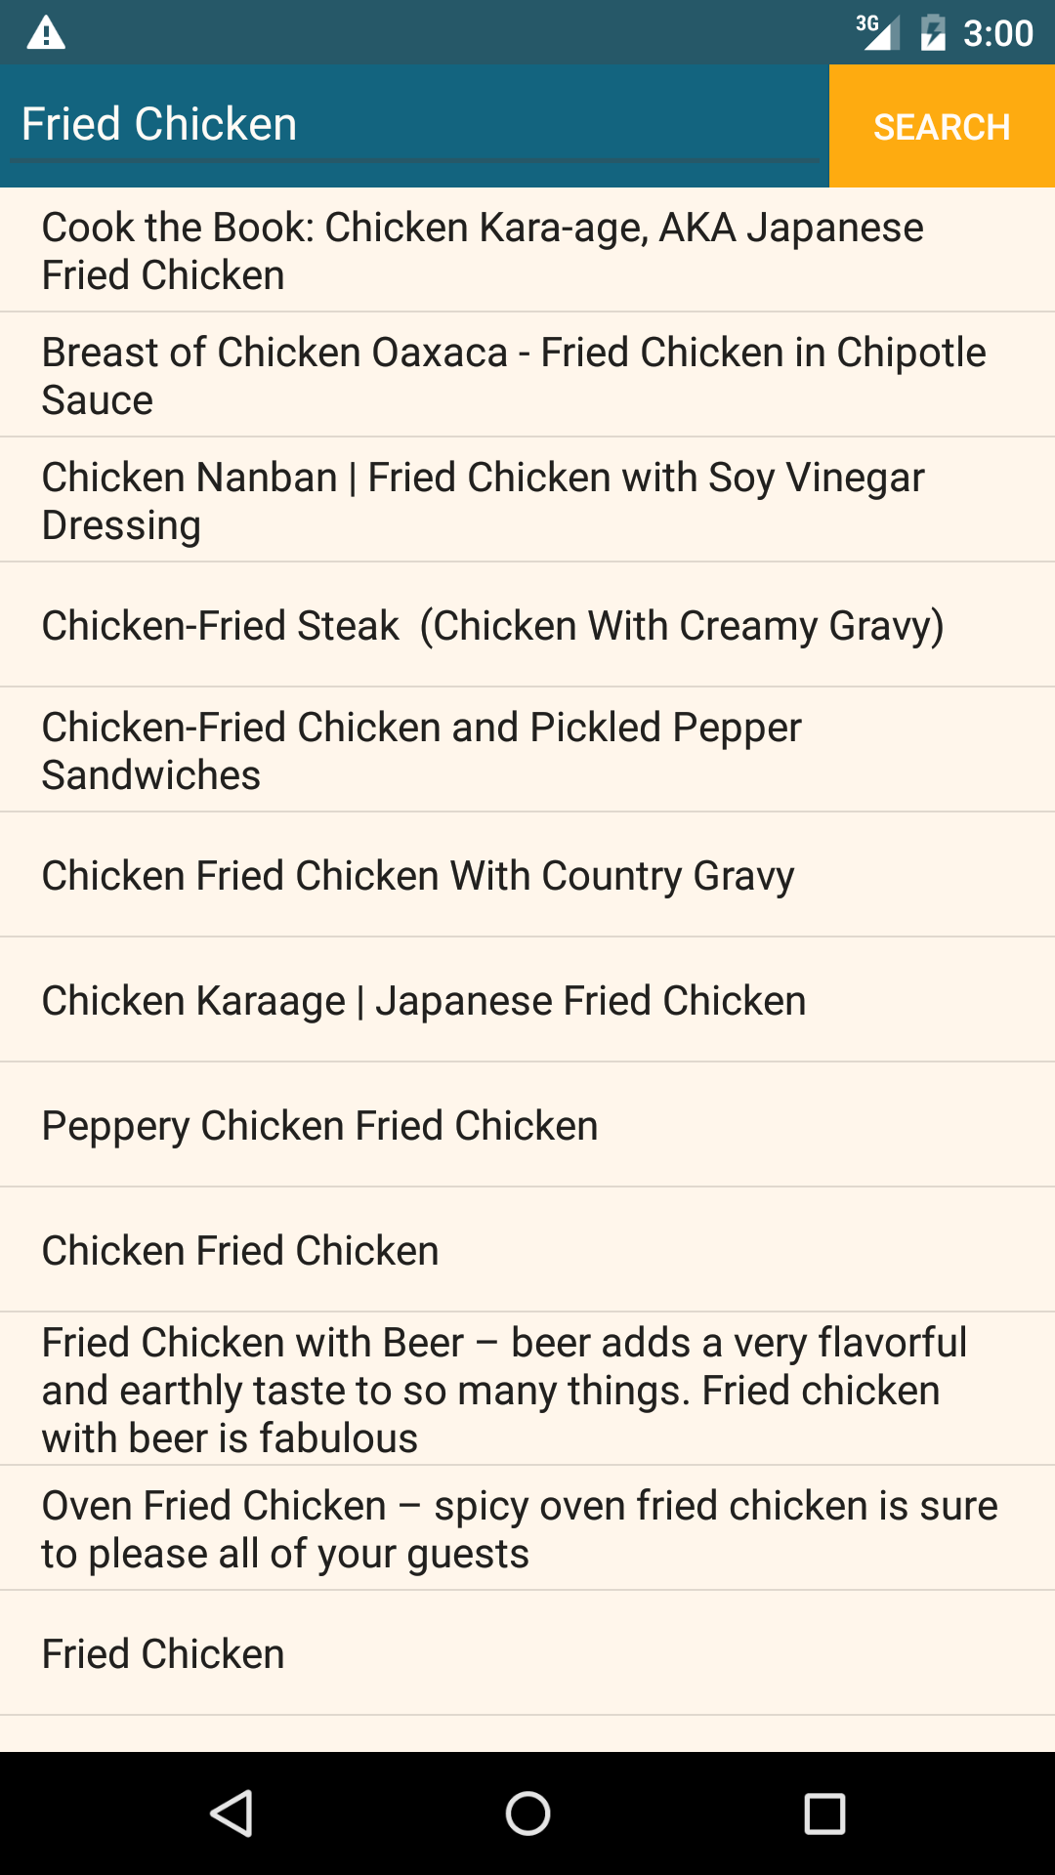
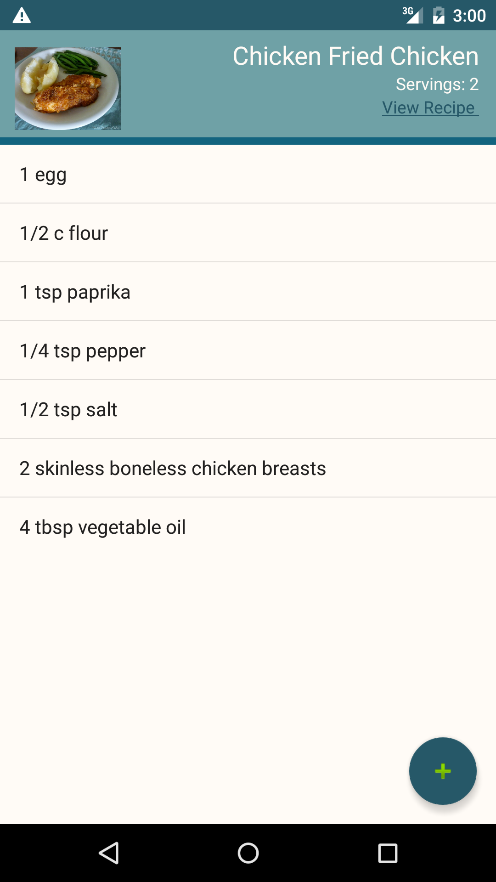
Recipe Lookup
Notes:
OMAR

Slide 23
Recipe Lookup
Tried Multiple APIs to no avail:
BigOven API -- Lack of Documentation
Edamam API -- Expensive
Settled on: Spoonacular API
Pros:
Great Documentation
Cheap
UNIREST API
Cons:
Pulls Recipes from Multiple Sites - Inconsistent data in JSON form
Notes:
OMAR

Slide 24
Spoonacular API
Input: Recipe ID
Output: JSON Object with:
~24-30 Fields
Arbitrary # of Inner JSON Objects with 8 Fields
Create a POJO for Each Recipe
SLOW, may Crash with input mismatch
Dynamically Parse Input by Treating JSON as a DFA
State switch depending on current Token
FAST, will not Crash, get only what you need
Notes:
OMAR

Slide 25
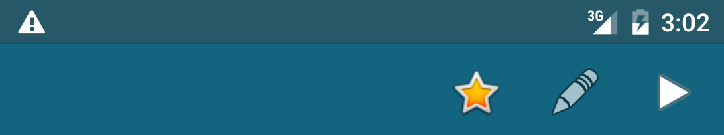
UI Design
Button Position and Choices
WYSIWYG
Keyboard Functionality
Pressing Enter, Touching EditTexts
Timed Events:
Creation of List -> Viewing List
Deletion of Main List
Threads
Application Life Cycle
OnCreate/ OnKeyDown/ OnBackPressed
Back to Page
Notes:
OMAR

Slide 26
Notes:
OMAR

Slide 27

Place your screenshot here
Now for a Live Demo

Slide 28
Thanks!
Any questions?
You can find us at
@ovoapp
http://tiny.cc/ovoapp

Slide 29
Future Hopes & Dreams
User Logins
Share Recipes
More UI Touch Ups -> Access Create New and Lookup from ALL
Sortable Grocery Mode
Product Categories
Setup Reminders

